Slide 1

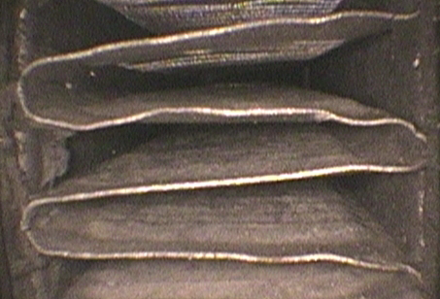
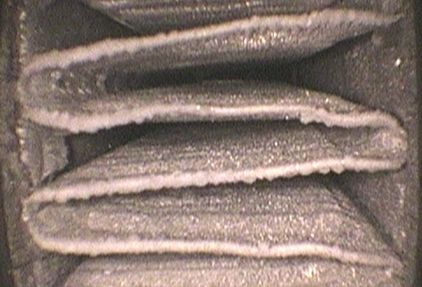
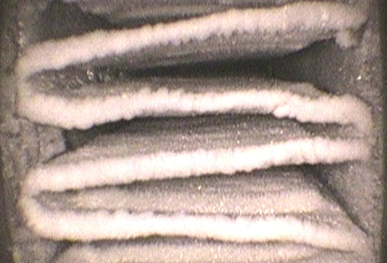
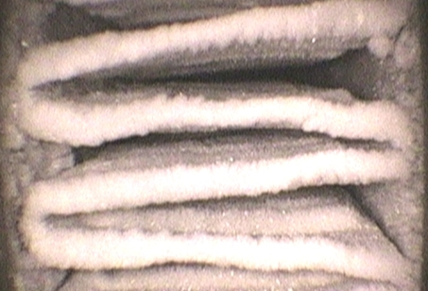
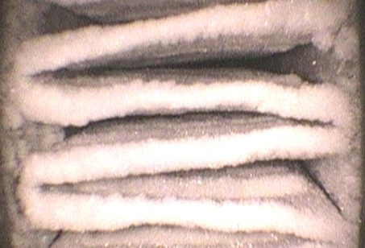
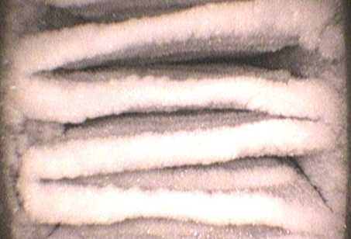
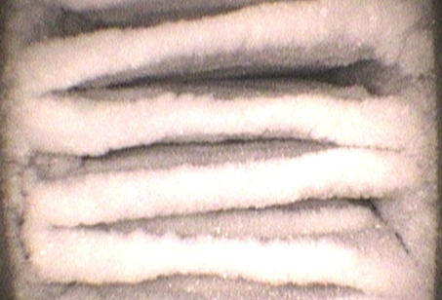
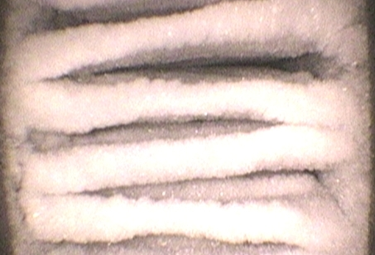
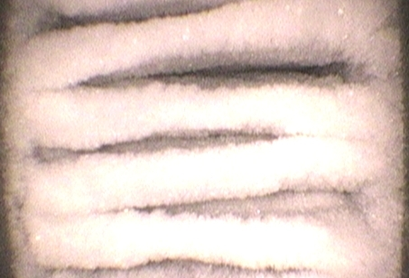
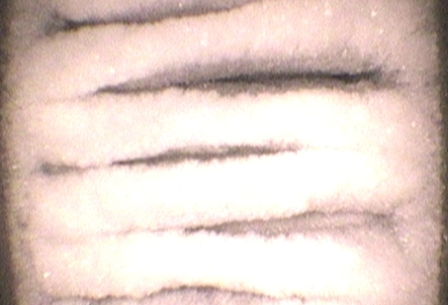
Page 6 of 22
Results, Frost Images
8 mm
Sample 3
(20 FPI )
8mm
(Tsurf= -8°C)
Time (min):
0
2
5
7
9
12
14
16
18
21
2
Test terminated:
(air face
velocity
reduced from 1.5m/s
to 0.25m/s)
Air condition: 1.7°C/0.6°C db/wb (AHRI)

